Slide 1
Use case - Petroleum system evaluation
Goal of the presentation
Short intro about petroleum system
Contextualize the use case in geoscientists’ prospect maturation workflow.
Current status of the use case.
Elaborate what kind of questions the reasoning engine should be able to answer.
Discuss the way forward – what shall we add to make the use case more complex and be able to answer more questions

Slide 2
Petroleum system elements and processes Introduction
The goal for exploration (for petroleum system evaluation) is to find areas (prospects) where there are hydrocarbons.
Hydrocarbons will be found if:
Hydrocarbons are formed inside a kitchen (Source rock) from organic matter
Hydrocarbons are migrated from the Source rock into a porous and permeable rock (Reservoir rock)
Migration takes place through migration pathways:
Faults, should be non-sealing
Porous carrier beds, continuous and sealed by a continuous non-porous rock
Combination of faults and porous carrier beds
Hydrocarbons are accumulated inside a trap
The trap must have been formed before the hydrocarbons started to migrate
The type of trap is important
Hydrocarbons are retained and preserved inside the trap after accumulation until present day
The trap must maintain the integrity
Hydrocarbons should maintain their quality (no degradation)

Slide 3
Petroleum system elements and processes Introduction
The essential elements of a petroleum system include:
Source rock
Reservoir rock
Cap (Seal) rock
Overburden rock
Petroleum systems have two processes:
Trap formation
Generation–migration–accumulation of hydrocarbons
**** If one of these elements or processes is not present than there is no petroleum system.

Slide 4
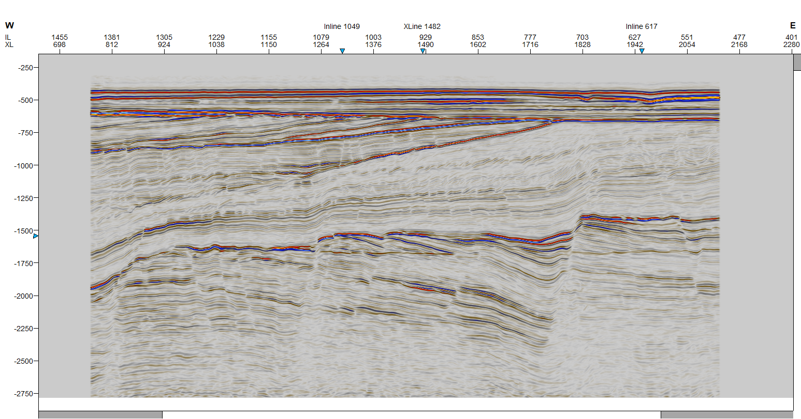
Contextualize use case in geoscientists’ prospect maturation workflow
What do we know (before started the evaluation)?
We know the location – Northern North sea
We recognize the limit between the Creatceous / Jurassic sequnces of sediments (Base Cretacous Unconformity = BCU) -> the geological age -> which kind of depositional environments these sequences
have been deposited in
We also know that Jurassic is deivided into Lower, Middle and Upper Jurassic
SR was deposited during Upper Jurassic, its lithology is shale, deposited in marine environment
Reservoir rock has deposited throughout all the Jurassic period in different depositional environments
Cretaceous sediments
Jurassic- Triassic and older sediments

Slide 5
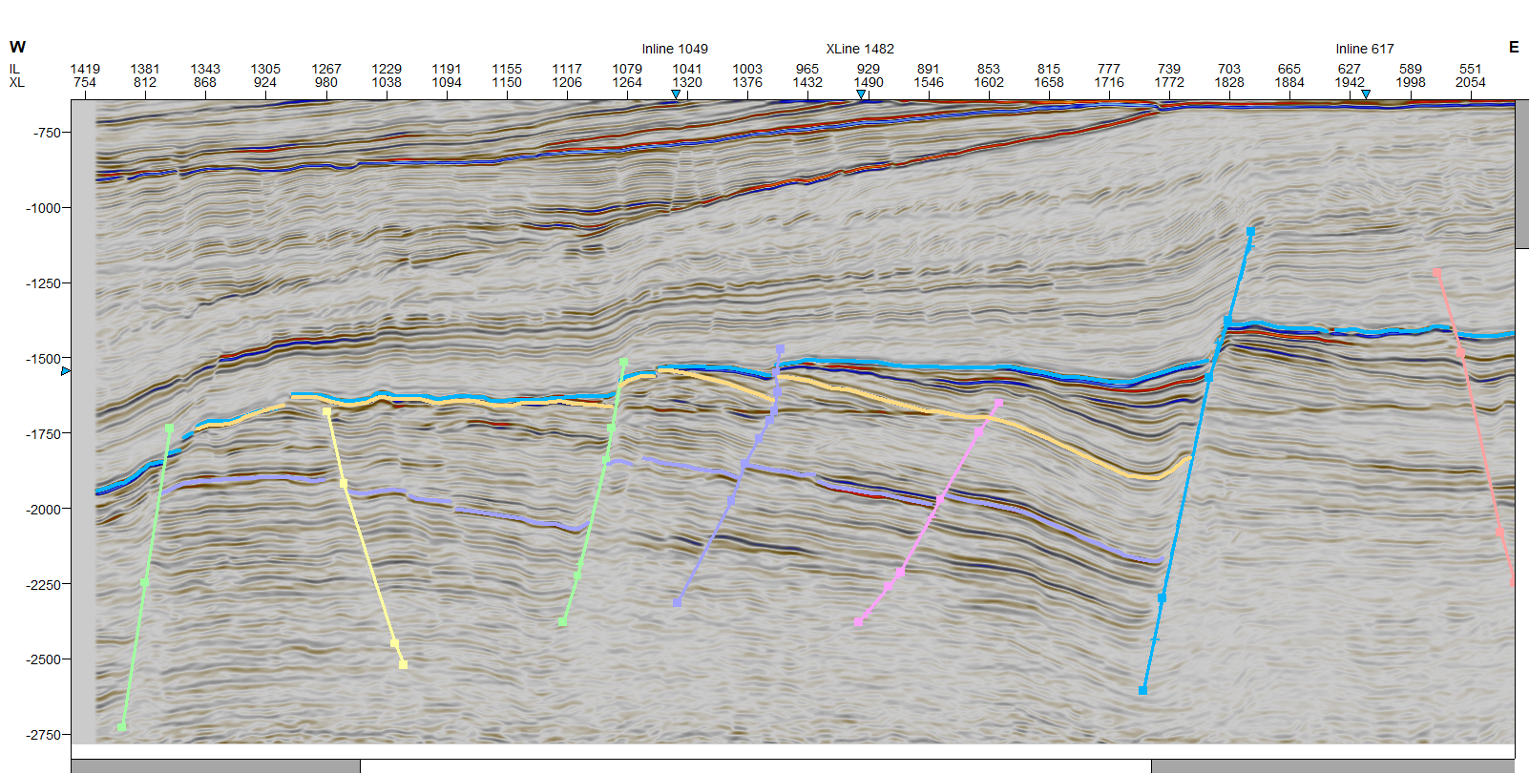
Contextualize use case in geoscientists’ prospect maturation workflow
Interpretation
We interpret the faults
Interpret different geological units: Top and base of SR, top and base of reservoir(s)?
Pre-rift sediments – deposited before the faulting started -> constant thickness over extended areal
Syn-rift sediments – deposited during the faulting -> development of wedges-like sequences
Post rift sediment – deposited after the faulting ceased
We see a Flat spot – represent the base of HC accumulation?
==> leads 1 and 2
Structures -> = based on the cross-cutting relationship we can infer the timing of the faulting -> timing of the trap formation
Lead 1
Lead 2
Kitchen (SR) ?
BCU
Kitchen (SR)

Slide 6
Contextualize use case in geoscientists’ prospect maturation workflow
To convert the leads into prospects
we need to convert some of the unknown into the known.
What we do not know?
What is the lithology of these geological units?
Where are the reservoir rocks and what is the their quality?
What kind of lithology do they have?
What is the source for these sediments?
What are the seal rocks (top and lateral)?
Is there one seal, more than one, are they continuous, what is their lithology?
Where is the Kitchen (SR)?
We know that it was deposited in the Upper Jurassic, but where is located, it was deep enough burried to generate Hc?
2 different kitchens?
Possibility of 2 different SR?
What are the migrations pathways?
Lead1
Lead 2
SR ?
BCU
Kitchen (SR)

Slide 7
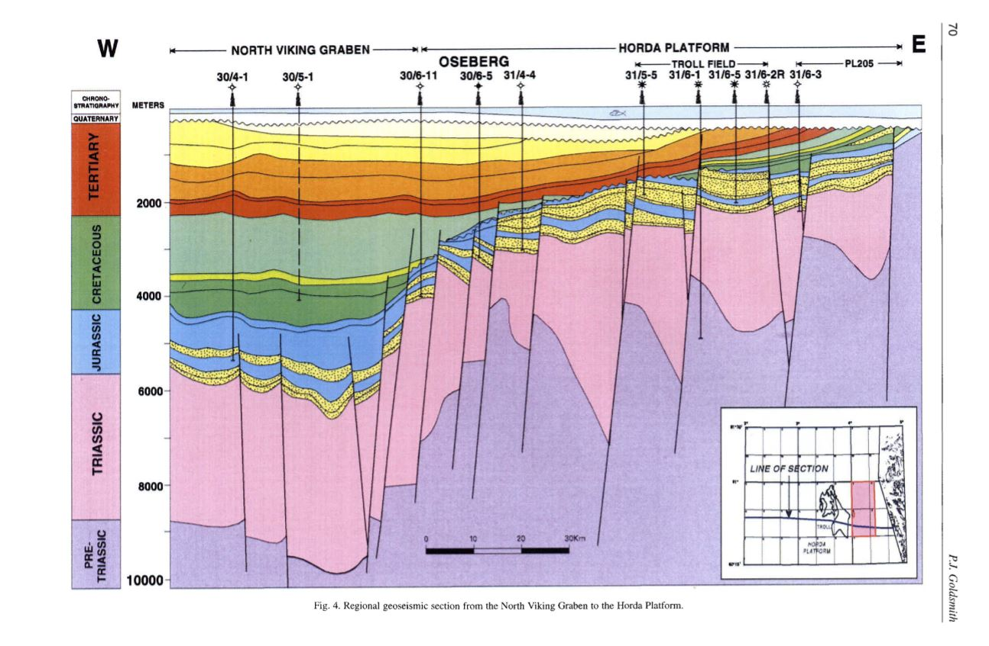
Contextualize use case in geoscientists’ prospect maturation workflow
The most likely scenario looks like this
How do we come up to this interpretation if we have no wells drilled
using conceptual model for deposition of sediemnts

Slide 8
Use case – current status
We assume that the SR exists, has been deposited in marine environments, has kerogen type II, and has generated oil and gas
We assumed that the migration took place and we know when the migration started, we have assigned an age for this process
We have defined the fill-spill migration model
We have defined migration pathways:
Direct migration from SR into the reservoir
Migration through carrier bed (equivalent with the reservoir rock) and across / along the faults
We assumed that the carrier beds are porous and permeable
We assume that the reservoir rock is present and the lithology is sandstones of good quality (porous, permeable)
We assume that the seal rock is present and effective, and the lithology is shale
We have defined traps – fault dependent traps
Trap geometry
Structure – rotated fault blocks (dipping units)
Top seal, lateral seal
Sealing capacity of the faults – sealing, non-sealing, or unknown
Possible filling of the trap based on its geometry
Fill to structural spill
Fill to sand juxtaposition point
Filled to clay smear rupture
We have defined the accumulation process
W
E
Trap 4
Trap 3
GU12
Trap 2
GU11
?
GU9
GU10
Trap 1
GU6
GU8
GU5
GU7
GU3
GU4
F3
GU2
?
GU1
F2
SR
F1
F4

Slide 9
Questions to ask It is possible to have accumulation in Trap3 ?
W
E
Trap 4
GU12
Trap 3
GU11
?
Trap 2
GU9
GU10
Trap 1
GU6
GU8
GU5
GU7
One way for the reasoning engine to answer this question is :
Yes, if :
There is a trap ->a reservoir rock (GU8), a top seal (GU9) and a lateral seal (F3 sealing or lateral seal, GU 10), to allow accumulation of HC
What is the trap geometry (the answer should be = It is a fault dependent trap, with the reservoir GU 8 sealed on top by GU 9 and laterally by GU 10 or by F3) -> trap 3 does not depend on the F3 to be sealing to have accumulation
The trap has been formed before the migration started
The trap has been formed after the deposition of GU1 – G12
There is a SR that has generated and expulsed HC - YES
Where is the Kitchen (SR)?
SR is located to the west -> a fill-spill migration model is required
In which depositional environment has been deposited -> what is the lithology
Marine depositional environment
What kind of HC has been generated
What is the age of the SR
What is the timing of the migration
There are migration pathways from the SR into the trap 3
What are the possible migration pathways
Migration pathway is made of a combination of carrier beds (GU2, Gu5 and GU8) and faults (F1 and F2)
What are the condition for these pathways to allow migration
Faults, F1 and F2 should be non-sealing
Carrier beds (GU2, GU 5 and GU 8 )should be permeable, porous and homogeneous
Trap 1 and Trap 2 should be filled until their maximum (Trap 1 can be filled to spill if GU 4 and the GU below Gu 4 are low permeable andlow porous rocks, Trap 2 can be filled only until the juxtaposition point)
The faults have been formed before the migration strated
If the migration strated after the trap and migration pathways formation
No, if:
GU3
GU4
F3
GU2
?
GU1
F2
SR
F1
F4

Slide 10
Questions to ask
Another way to ask and answer questions is to ask question separately about each element and process of the petroleum system:
What are the traps that have a lateral seal -> do not depend on the faults to be sealing?
Which traps can be filled to structural spill?, Which traps can be filled to juxtaposition point?, Which traps depends totally on faults to be sealing to have accumulation?
What are the migration pathways from the SR to trap X?, What are the variables?
Were the traps formed before the migration strated?
What kind of HC do we expect to have been accumulated in the traps?

Slide 11
Way forward – what to add
There is not so much to add about migration and migration pathways, trap geometry or filling of the trap
We can add:
More information about faulting (rifting)
When the fault movement ceased – based on the rule of cross-cutting relationship
To be able to clasify or separate traps based on their timing
Which faults were active during deposition of Upper Jurassic ? –> thicker sequence of sediments in the hangingwall of the active faults
Which GU have been deposited before faulting, during and after the faulting?
More information about reservoir
In which deposition environment Lower / Middle Jurassic and Upper Jurassic sediments have been deposited – what is the most likely lithological distribution - vertical and lateral
Ex: in a beach depositional environemnt, thick sequences of good quality sandstone are present, very little shales intercalated -> after faulting the sands will be juxtaposed
Information about the seal rock
Is there a seal rock present based on the depositional environments?
What is the lithology of the seal rocks
Is the seal represented by 1 GU, or more than 1
Are the seal rocks continuous above the reservoir?
Ït is possible to have 2 kitchens?
If yes, what are the implications for the type of hydrocarbons to be find inside the trap

Slide 12
To use this picture as Use Case ? (Troll field – without wells)
W
E
Lower Cretaceous
Upper Jurassic SR
Upper Jurassic reservoir
Middle Jurassic
Triassic and Lower Jurassic

Slide 13
Thank you!

Slide 14
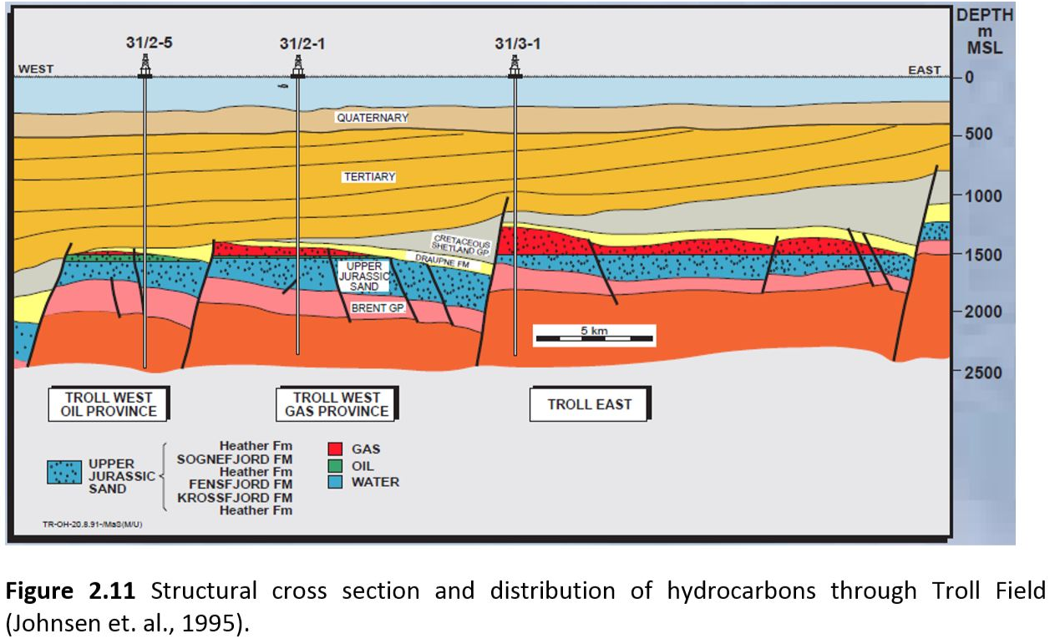
To add – use this concret use case (Troll field – without wells)

Slide 15
Source rock
A source rock is a rock that is capable of generating or that has generated movable quantities of hydrocarbons
Source rock is evaluated in terms of presence, quality, quantity and maturity.
Is there an effective source rock present?
We assumed that the source rock is present
Depositional environment controls the amount of organic carbon contained in a rock.
Source rocks are generally associated with areas where high organic productivity is combined with deposition in poorly oxygenated environments (anoxic to dysaerobic), upwelling, and rapid sedimentation. These processes preserve organic matter.
What type of lithology of source rock is expected?
Shale, coal, limestone
Did the source rock contain enough organic matter to generate hydrocarbons? – richness
We assumed that SR has generated enough HC
What kind of hydrocarbons is able to generate? - quality
If the kerogen is of type I than oil is generated.
If the kerogen is at type II than oil and gas are generated.
If the kerogen is of type III than the gas is generated.
If no information about the kerogen type is available than the depositional environment can be used as kerogen type indicator.
If the source rock was deposited in a lacustrine environment than the kerogen will be type I.
If the source rock was deposited in a marine environment than the kerogen will be type II.
We assumed that the ST has been deposited in marine environment -> kerogen type II -> oil and gas
If the source rock was deposited in a terrestrial environment than the kerogen will be type III.
Is the source rock mature enough?
Volume of mature source rock within drainage area
It is possible to have a secondary source rock present, charging my trap?
This has impact on the hydrocarbons type present
Maybe something to add?

Slide 16
Migration
Did the hydrocarbons migrate from the source rock?
Yes
When did they migrate? – we input a time ( million years or geochronologic time) :50 ma ago (Cretaceous)
This time should be correlate with the time of trap formation, discussed below
What are the migration pathways (how long is the migration distance)?
If the source rock is adjacent (in contact with) to the reservoir rock than the hydrocarbons can migrate directly into the reservoir rock.
If the source rock is located far away from the reservoir rock than carrier beds are required.
Carrier beds can be a continuous permeable rock, faults or a combination of both.
A continuous regional seal above the permeable rock is required
The most effective migration is when the hydrocarbons are migrated laterally and/or vertically without barriers.
The less effective migration is when the hydrocarbons are migrated vertically with barriers and when there is a long-distance “fill-spill” migration.
Migration models are required.

Slide 17
Reservoir
A reservoir is a porous and permeable rock, capable of accumulating hydrocarbons.
Is there an effective reservoir rock present?
We assumed yes
What kind of depositional system the reservoir rock was deposited in? – To add
What is the vertical and lateral facies distribution?
What is the thickness variation?
What is the prospect location compared to the anticipated distribution of the reservoir facies?
Proximal or distal to the source of sediments
What type of lithology of the reservoir rock is expected?
We assumed sandstone
What is the quality of the reservoir rock?
What is the thickness?
Thickness maps based on seismic data can give a good estimate
What is the N/G (net to gross) ratio?
Knowing the depositional environment and the location of the prospect inside the depositional environment can give a rough estimate of the sand/shale ratio.
What is the lateral extent?
Seismic data together with facies map can be used
What is the porosity?
What are the diagenesis that could have affect the porosity?
Based on the depositional environment what kind of clay minerals are present?
Based on the depositional environment what kind of pore-water chemistry is expected and what kind of cement can form?
What are the diagenetic processes that can preserve or enhance porosity?
What are the diagenetic processes that can destroy porosity?
Is there any overpressure?
Overpressure may maintain high porosity of greater depths.

Slide 18
Trap
“A trap consists of a geometric arrangement of permeable (reservoir) and less-permeable (seal) rocks which, when combined with the physical and chemical properties of subsurface fluids, can allow hydrocarbons to accumulate.”
A trap may or may not contain oil or gas. Accumulations are traps that contain oil or gas.
Is there a trap to allow hydrocarbons to accumulate?
When did the trap formed?
The trap must be formed before the onset of hydrocarbons migration.
We assigned and age to the faulting
What kind of trap is it?
Structural
Anticline
Fault(s)-dependent
Stratigraphic
Combined
Is the trap effective based on its sealing capacity? – we reason about sealing capacity of the faults and different filling of the trap
If the trap is fault (s) dependent than we need to have an effective cap rock and a sealing fault
There may be cross-sealing faults, which prevent communication of hydrocarbons between juxtaposed sands (reservoirs).
A fault is cross sealing if it juxtaposes hydrocarbon-bearing sands with water-wet sands.
A fault is also cross sealing if it juxtaposes sands with different hydrocarbon contacts and/or different free water levels.
Different pressure across the fault imply cross seal.
There may be dip-sealing faults, which trap hydrocarbons against the fault plane.
If the trap is an anticline than only cap rock is needed to be present and extend above and around the reservoir.
If the trap is a horst than we need to evaluate the sealing properties of the cap rock and of the faults.
The faults may seal in one point and leak in another
What is the possible filling of the trap?
Fill to synclinal spill
Fill to sand-sand juxtaposition point
Filled to clay smear point

Slide 19
Cap (Seal) rock
“Cap rock is defined as a relatively impermeable rock, commonly shale, anhydrite or salt, that forms a barrier or seal above and around reservoir rock so that fluids cannot migrate beyond the reservoir.“
Is there a cap rock present?
We assumed yes – should be correlated with the deposition environment and tectonic evolution of the area
What is the lithology of the cap rock?
Main cap rocks are shale, salt and anhydrite
Salt, anhydrite are considered as having very good sealing properties
Thick shales have good sealing properties
Thin shales have poor to acceptable sealing properties
Juxtaposition, fault planes depend on sand/shale or sand/sand contact
What is the effectiveness of the cap rock? What is its lateral extent?
The cap rock must extend over the entire reservoir section inside the trap in order to be effective.

Slide 20
Retention after accumulation
It is not enough just to know that a trap is present in a basin where hydrocarbons were generated and migrated. We also must know that the trap was preserved over time.
Processes that can destroy the accumulation or alter the hydrocarbons quality
Hydrocarbon column

Slide 21
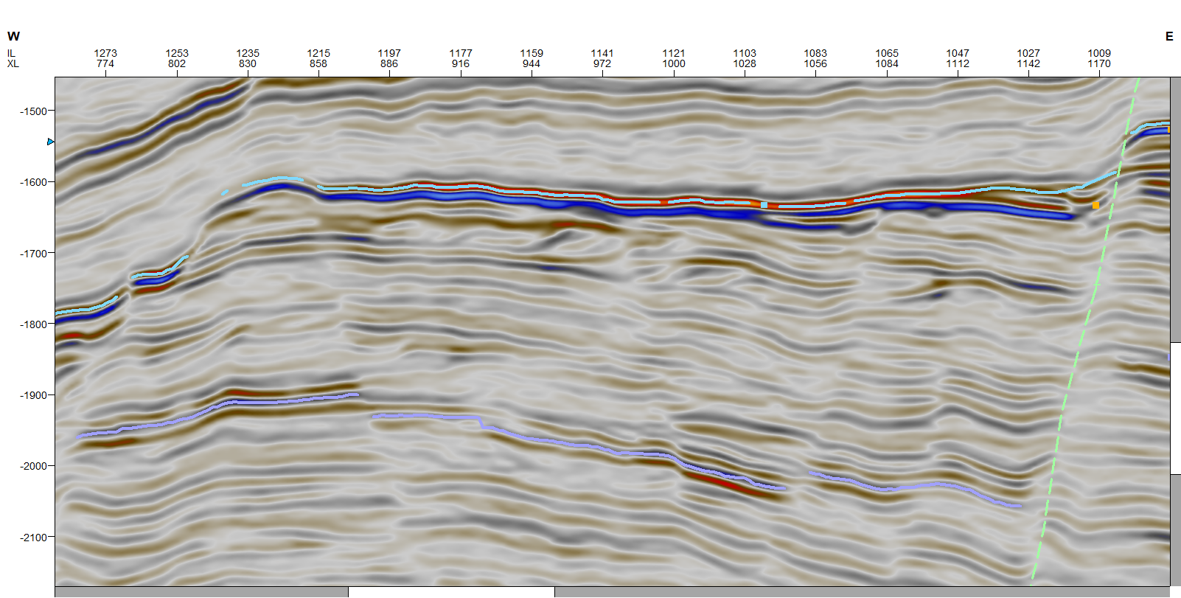
How to recognize reservoir rocks on seismic
Clinoforms
dipping to the west – > source of the sediments located to the east
Typically occur in delta front, shelf slope and continental marginas

Slide 22
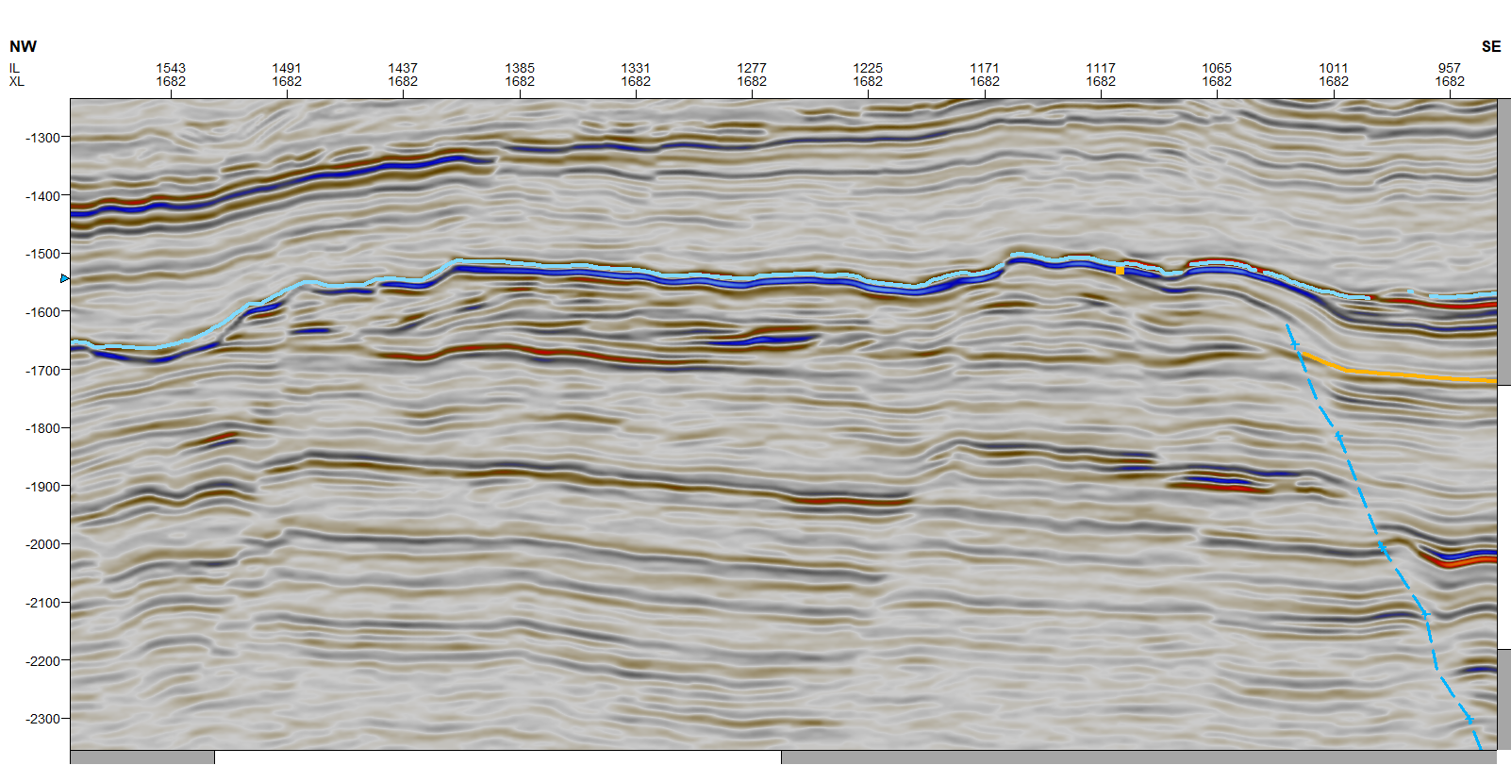
Clinoforms

